Slide 1
Project Pima Indian diabetes
janani.m
IOA Batch 9

Slide 2
Project objective
● This dataset is originally from the National Institute of Diabetes and Digestive and Kidney Diseases.
● The objective of the dataset is to diagnostically predict whether or not a patient has diabetes, based on certain diagnostic measurements included in the dataset
● TO USE CLUSTERING TECHNIQUES TO CLASSIFY PATIENTS

Slide 3
Problem description
● Data mining and machine learning is helping medical professionals make diagnosis easier by bridging the gap between huge data sets and human knowledge. We can begin to apply machine learning techniques for classification in a dataset that describes a population that is under a high risk of the onset of diabetes.

Slide 4
Data set description
This dataset is originally from the National Institute of Diabetes and Digestive and Kidney Diseases
The datasets consists of several medical predictor variables and one target variable, Outcome. Predictor variables includes the number of pregnancies the patient has had, their BMI, insulin level, age, and so on.

Slide 5
Flow diagram
PIMA DATA SET
IMPORT DATA
VISUALIZE DATA
SCALE THE DATA
CLUSTERING THE DATA
COMPARE CLUSTERS WITH ORIGINAL DATA

Slide 6
Model to be used
● CLUSTERING TECHNIQUES
* K-MEANS CLUSTERING
* Hierarchical clustering

Slide 7
Algorithm description
● K-MEANS CLUSTERING : K Means Clustering is an unsupervised learning algorithm that tries to ‘’cluster data based on their similarity’’. Unsupervised learning means that there is no outcome to be predicted, and the algorithm just tries to find patterns in the data. In k means clustering, we have the specify the number of clusters we want the data to be grouped into.
● Hierarchical clustering :
Hierarchical clustering is an alternative approach which builds a hierarchy from the bottom-up, and ‘’doesn't require us to specify the number of clusters’’ beforehand.

Slide 8
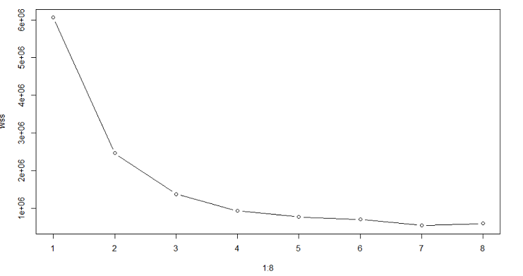
K-MEANS CLUSTERING
k-means clustering is a method of vector quantization, originally from signal processing, that is popular for cluster analysis in data mining. k-means clustering aims to partition n observations into k clusters in which each observation belongs to the cluster with the nearest mean, serving as a prototype of the cluster. This results in a partitioning of the data space into Voronoi cells.

Slide 9
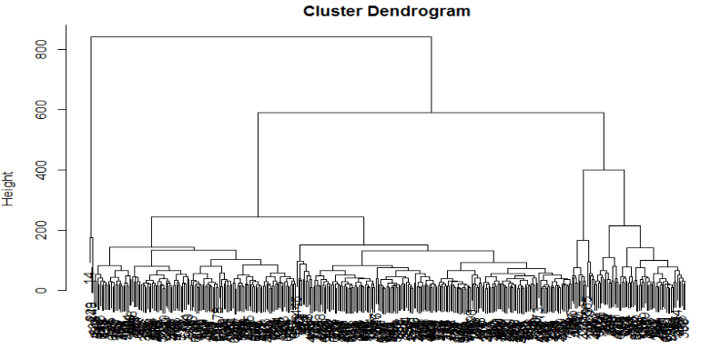
Hierarchical clustering
Agglomerative: This is a "bottom up" approach: each observation starts in its own cluster, and pairs of clusters are merged as one moves up the hierarchy. Divisive: This is a "top down" approach: all observations start in one cluster, and splits are performed recursively as one moves down the hierarchy.

Slide 10
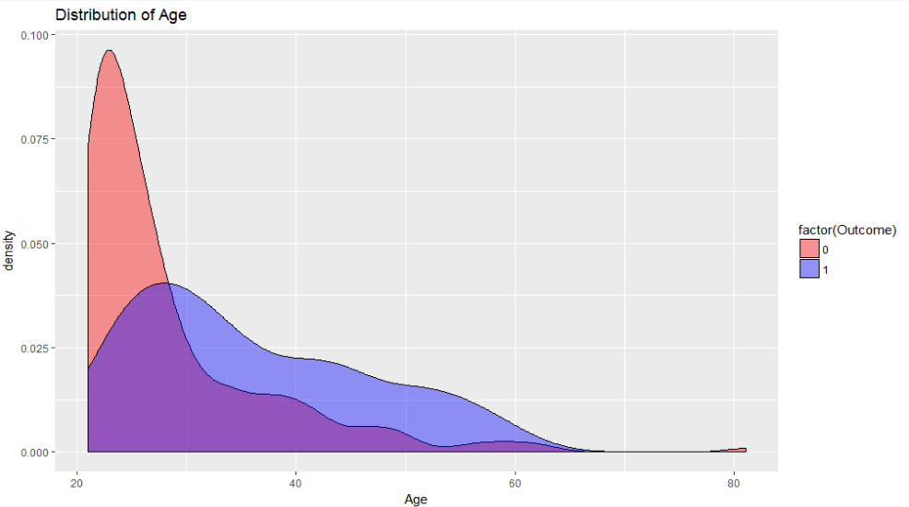

#Check what is the impact of age over the Outcome
ggplot(pima,aes(x=Age,fill=factor(Outcome)))+geom_density(alpha=0.4)+scale_fill_manual(values=c("red", "blue"))+labs(title="Distribution of Age")

Slide 11
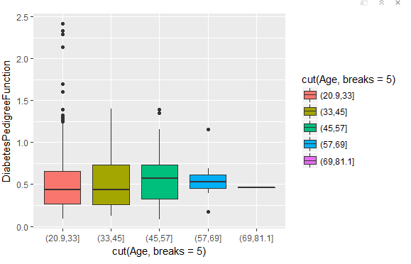
Diabetespedigree function on age
At young age Diabetes pedigree function was high, as age goes on its get reduced

Slide 12
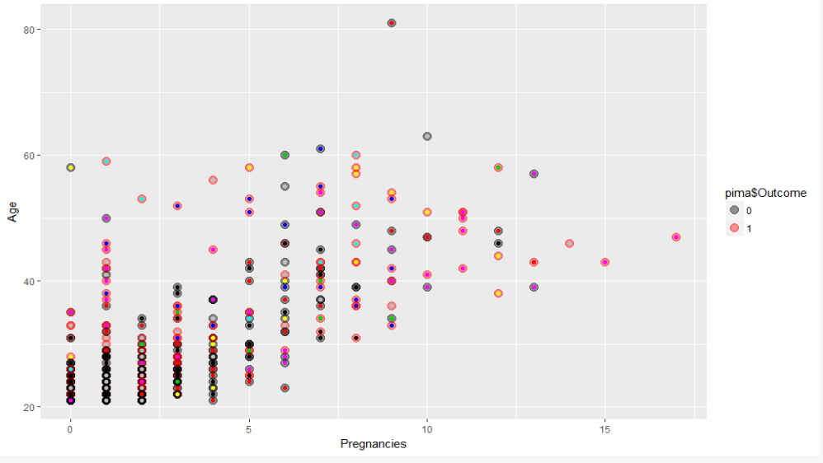
Clusters with original data
pima$cluster <- as.factor(diabetes_Clust$cluster)
ggplot(pima, aes(Pregnancies,Age,color = pima$Outcome)) +
geom_point(alpha = 0.4, size = 3.5) + geom_point(col = pima$cluster) +
scale_color_manual(values = c('black', 'red', 'green'))

Slide 13
EXPECTED OUTCOME
AUC = 0.835292 (not bad)
Accuracy : 0.7719
95% CI : (0.7119, 0.8247)
P-Value [Acc > NIR] : 0.00219
Prevalence : 0.3158
Detection Rate : 0.1711
Detection Prevalence : 0.2544
Mcnemar's Test P-Value : 0.07142
Pos Pred Value : 0.6724
Neg Pred Value : 0.8059
Balanced Accuracy : 0.7099

Slide 14
THANK YOU

